Slide 1

Proportional-integral-Derivative(PID) Controller
By team:

Slide 2
PID components and definition:
A PID controller adjusts system outputs to maintain desired setpoints using three mechanisms: proportional control (reacts to current error), integral control (corrects past errors), and derivative control (predicts future errors).
By summing these components, it ensures efficient process control and system stability. Before defining PID parameters, it's essential to understand closed-loop systems and related terminology.

Slide 3
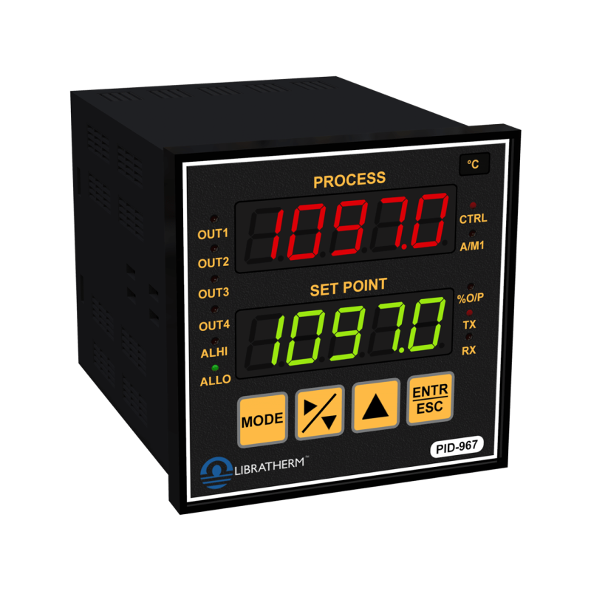
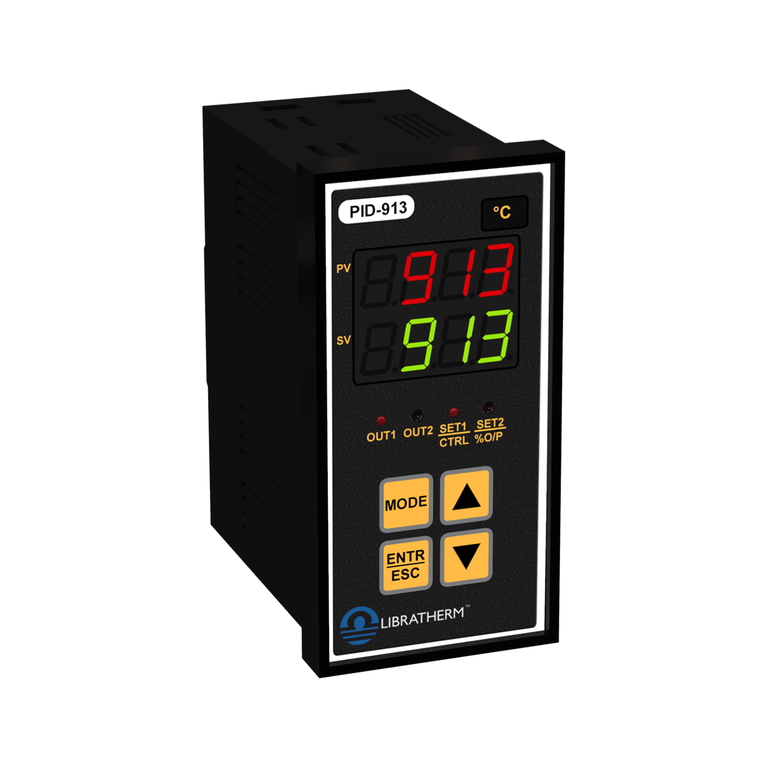
PID Controller:
Figure 1: High Accuracy PID Temperature Controller

Slide 4
-Closed Loop System:
the process variable is the parameter to be controlled (e.g., temperature, pressure).
A sensor measures this variable and provides feedback, while the set point is the desired value (e.g., 100°C).
The control algorithm calculates the difference between the process variable and the set point to determine the actuator's output, which adjusts the system (e.g., turning on a heater to increase temperature). This repeated process of feedback and adjustment forms a closed-loop control system.
External factors affecting the system, like cool air in a temperature chamber, are called disturbances, and control systems are designed to minimize their impact on the process variable.

Slide 5
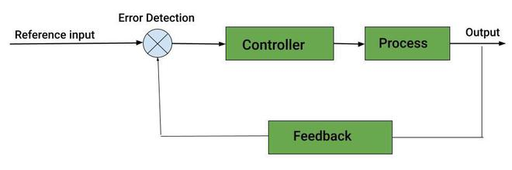
-Closed Loop System:
Figure 2: Block diagram of a typical closed loop system.

Slide 6
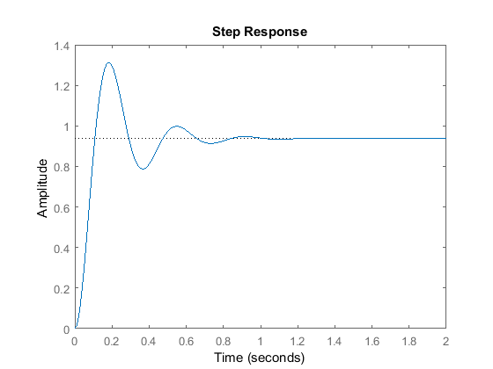
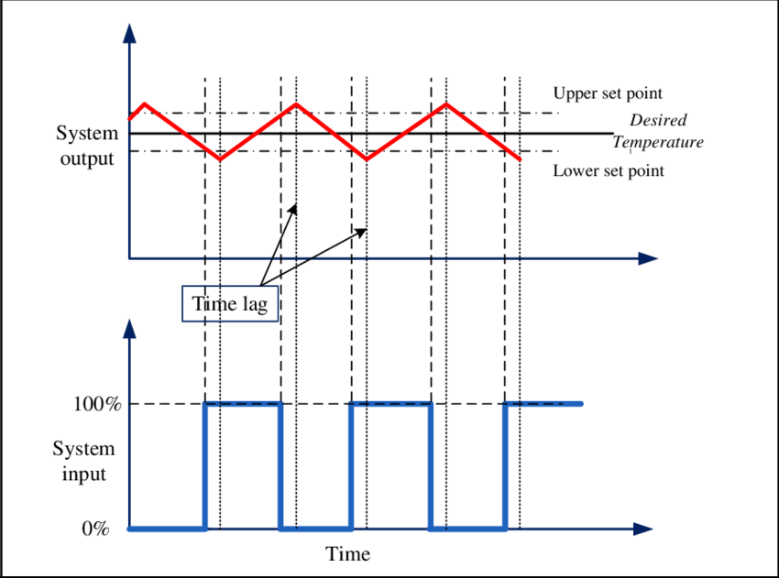
-Types of output signals:
Analog
Digital
Figure 3: Analog and Digital signal output of PID controller.

Slide 7
-Definition of terminologies:
The control design process begins by defining performance requirements, often measured using a step function as the set point. Key performance metrics include:
Rise Time: Time to reach 10%–90% of the final value.
Percent Overshoot: How much the process variable exceeds the final value, as a percentage.
Settling Time: Time for the process variable to stabilize within a specified range (e.g., 5%) of the final value.
Steady-State Error: The final difference between the process variable and the set point.
These definitions may vary across industries and academia.

Slide 8
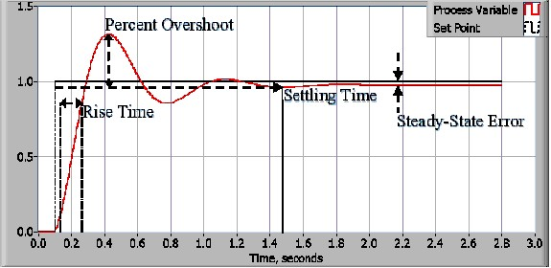
Figure 4: Response of a typical PID closed loop system

Slide 9
-Definition of terminologies:(Continued)
A control system's ability to meet performance requirements under worst-case conditions is measured by its disturbance rejection.
Robustness is a control system's ability to handle disturbances and nonlinearities across varying operating points.
Deadtime is the delay between a process variable change and its observation, often due to sensor placement or slow actuator response, impacting system performance.
Loop cycle time is the interval between control algorithm executions, with faster rates needed for rapidly changing or complex systems.

Slide 10
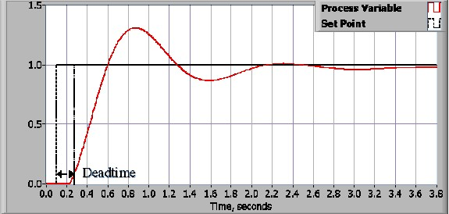
Figure 5: Response of a closed loop system with deadtime.

Slide 11
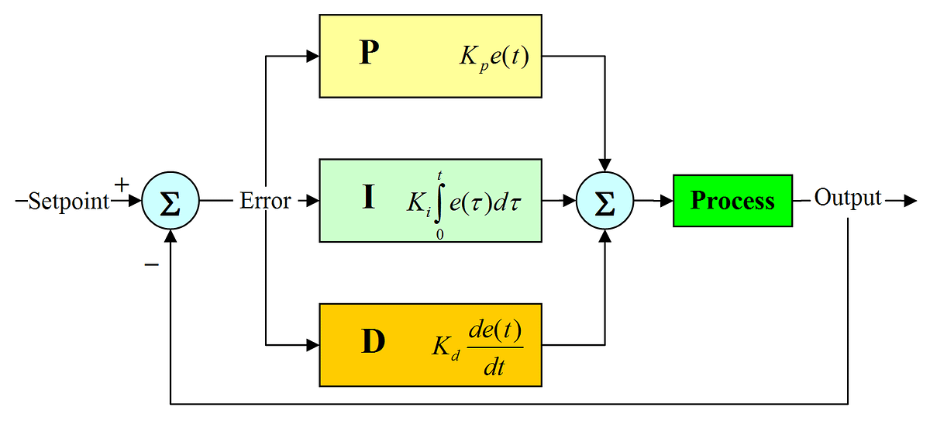
PID Theory:
Figure 6: Block diagram of basic PID control algorithm.

Slide 12
-Proportional Response:
The proportional component of a PID controller depends on the difference (error) between the set point and the process variable. The proportional gain (Kc) determines the output response relative to the error. Increasing Kc speeds up the system's response, but if it's too high, it can cause oscillations and lead to instability.
-Integral Response:
The integral component of a PID controller sums the error over time, gradually increasing even with a small error. It aims to eliminate steady-state error, the final difference between the process variable and set point. However, integral windup occurs when the integral action saturates the controller, preventing it from reducing the error signal toward zero.

Slide 13
-Derivative Response:
The derivative component of a PID controller responds to the rate of change of the process variable, reducing output if the variable is increasing rapidly. Increasing the derivative time (Td) enhances the system's response to error changes, speeding up the control system. However, most systems use small Td values to avoid instability caused by noise in the sensor signal or slow control loop rates.

Slide 14
Tuning:
PID tuning is the process of setting optimal gains for P, I, and D to achieve the ideal control system response. Common tuning methods include the "guess and check" method and the Ziegler-Nichols method.
The trial and error method for PID tuning involves adjusting the proportional gain until oscillation occurs, then fine-tuning the integral term to reduce steady-state error, while managing overshoot. The derivative term is adjusted to improve speed and reduce overshoot, though it can increase sensitivity to noise. Engineers balance these factors to meet system requirements.

Slide 15
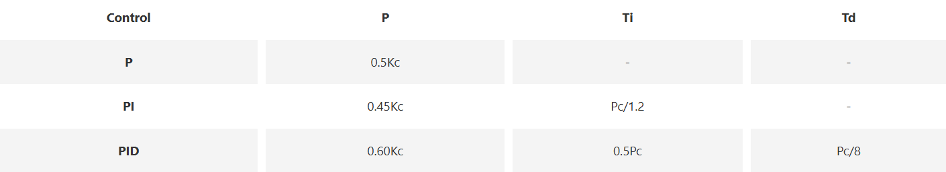
Tuning:(continued)
The Ziegler-Nichols method is similar to the trial and error method, where the integral and derivative terms are set to zero, and the proportional gain is increased until oscillation begins. The critical gain (Kc) and oscillation period (Pc) are then recorded, and P, I, and D are adjusted based on a set formula.
Table 1: Ziegler-Nickols tunning, using the oscillation method

Slide 16
Summery:
The PID control algorithm is a robust and simple algorithm that is widely used in the industry. The algorithm has sufficient flexibility to yield excellent results in a wide variety of applications and has been one of the main reasons for the continued use over the years.

Slide 17
Thanks

